Slide 1
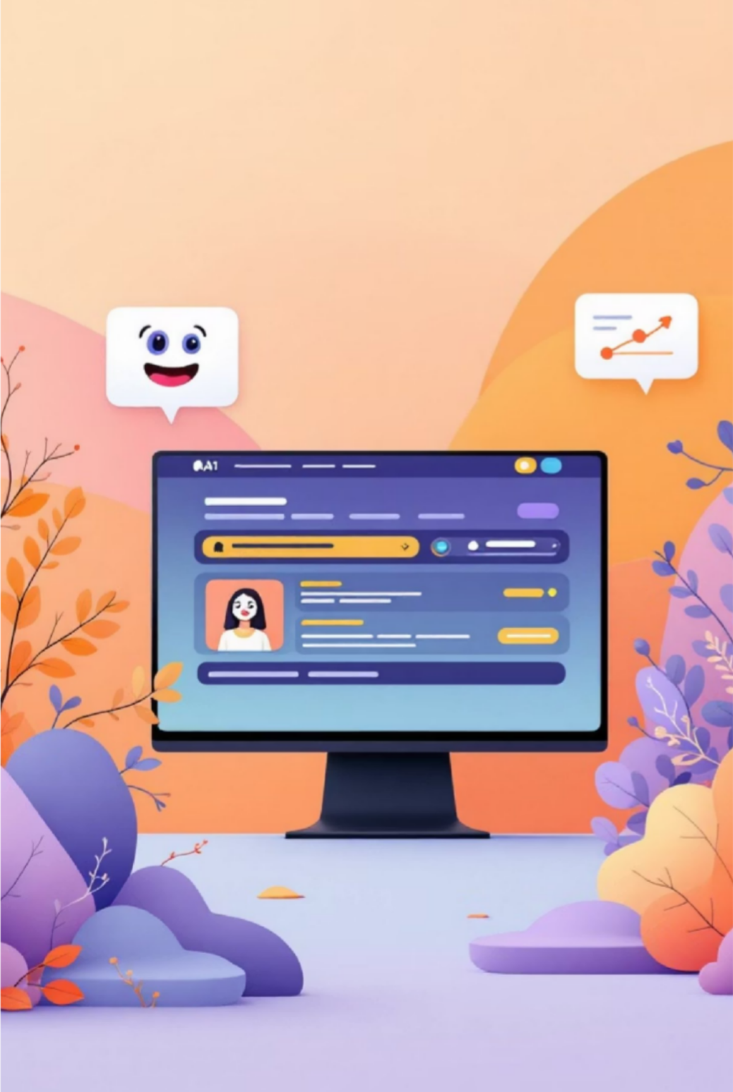
ResolveX :AI Complaint Resolver
Protected
Transforming complaint management through intelligent multi-agent automation across all customer touchpoints

Slide 2





Meet Team Sherlox
Protected
Toyota Connected India
We don't just find problems—we solve them. Customers deserve better, and we build it.
Abhishek R Shankar
TCIN Chennai, India
Sivashanmugam Ayyadurai
TCIN Chennai, India
Vigneshwar Santhanam
TCIN Chennai, India
Sathiyaseelan Raveendran
TCIN Chennai, India
Padmapriya Swaminathan
TCIN Chennai, India

Slide 3

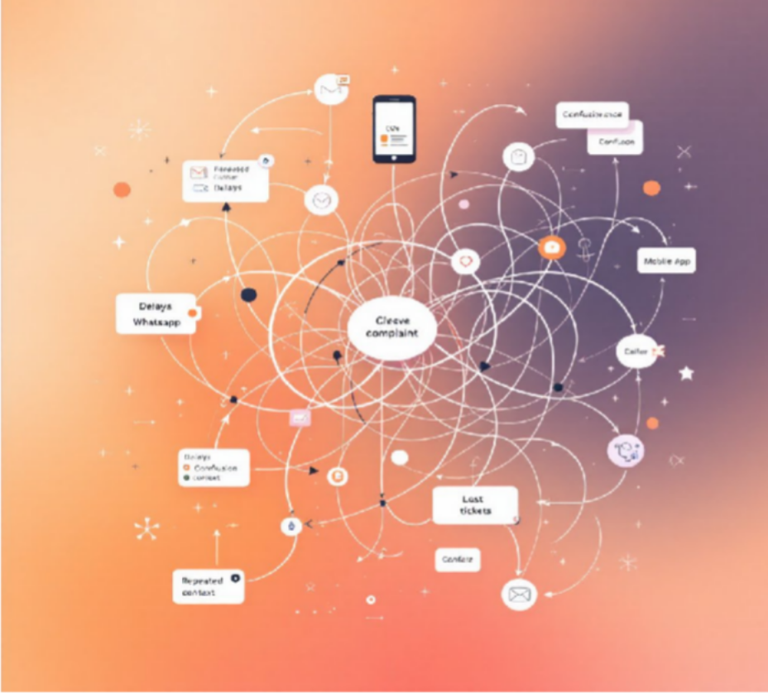
The Problem
Protected
Today's Reality
Each brand operates with different CRM systems, creating fragmented ticketing workflows that lead to painfully slow resolution times.
Customer Impact
The result is a cascade of negative outcomes: mounting customer stress, growing frustration, eroding trust, and an endless cycle of complaint escalations.

Slide 4

The Opportunity
Protected
$3.8T
Lost Sales
40-60%
Repetitive Issues
Global revenue lost annually due to poor customer experience
Of customer complaints are recurring problems
14×
Faster Resolution
Speed improvement with AI agent adoption
Vision: A single, unified AI system that seamlessly handles all customer complaints across every brand, platform, and touchpoint— creating massive whitespace for multi-agent automation in customer experience.

Slide 5
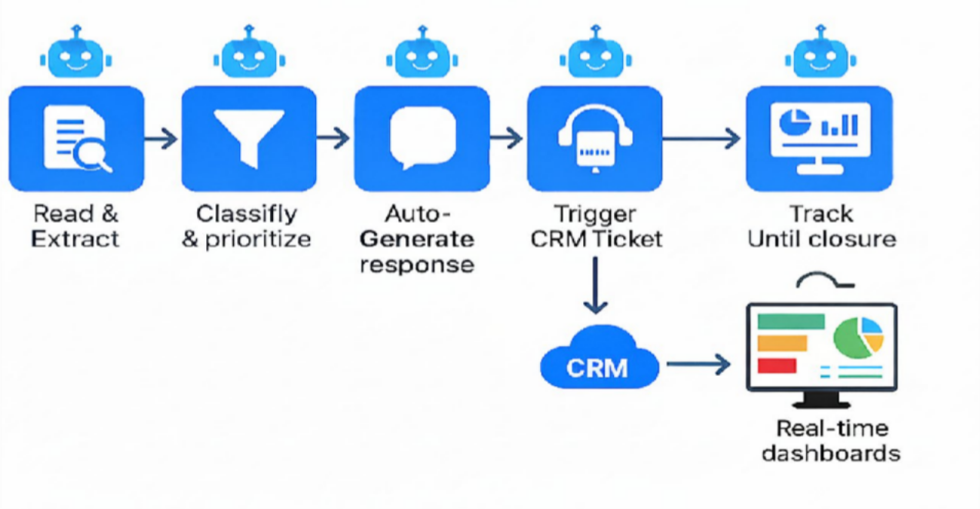
Introducing the AI Complaint Resolver
Protected
A Multi-Agent Pipeline for Seamless Complaint Resolution
The Automated Resolution Process
Ingest & Analyze
Automatically captures and processes customer complaints from every communication channel.
Classify & Prioritize
Intelligently sorts and ranks issues based on urgency, sentiment, and type for immediate action.
Generate & Personalize
Crafts context-aware, empathetic, and personalized responses in real-time.
Integrate & Escalate
Seamlessly creates and updates CRM tickets, initiating relevant workflows.
Powering the Solution:Core Capabilities
Monitor & Resolve
Diligently tracks each complaint through to its complete resolution.
Multi-agent orchestration engine
Universal CRM & ticketing API connectors
Cross-industry complaint understanding
Real-time analytics dashboards
Achieve Total Resolution: Experience end-to-end complaint closure with zero manual effort, deploying seamlessly
across apps, websites, browser extensions, or via API.

Slide 6






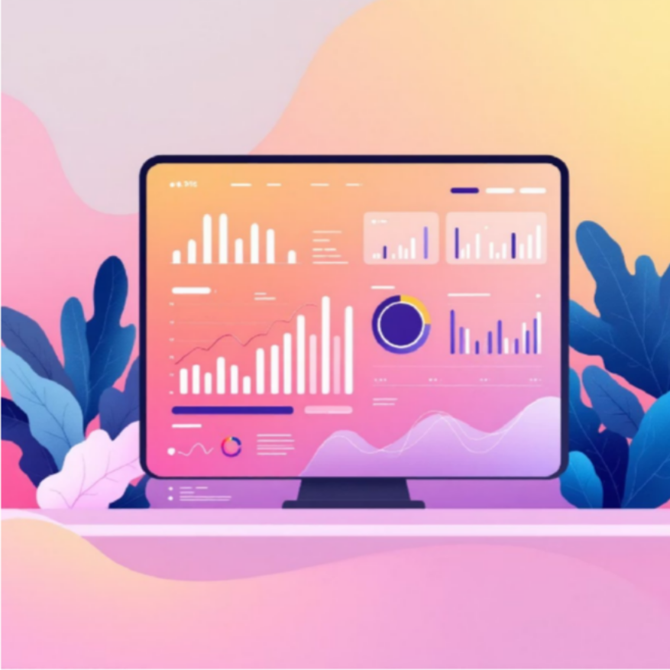
Live Prototype Demo
Protected
Key Features
Inbox View
Auto- ingestion of emails and chats
Classifier
Tags, sentiment, urgency detection
Auto-Response Intelligent
reply generation
Ticket Tracking
Resolution monitoring board
Analytics
CX insights dashboard

Slide 7
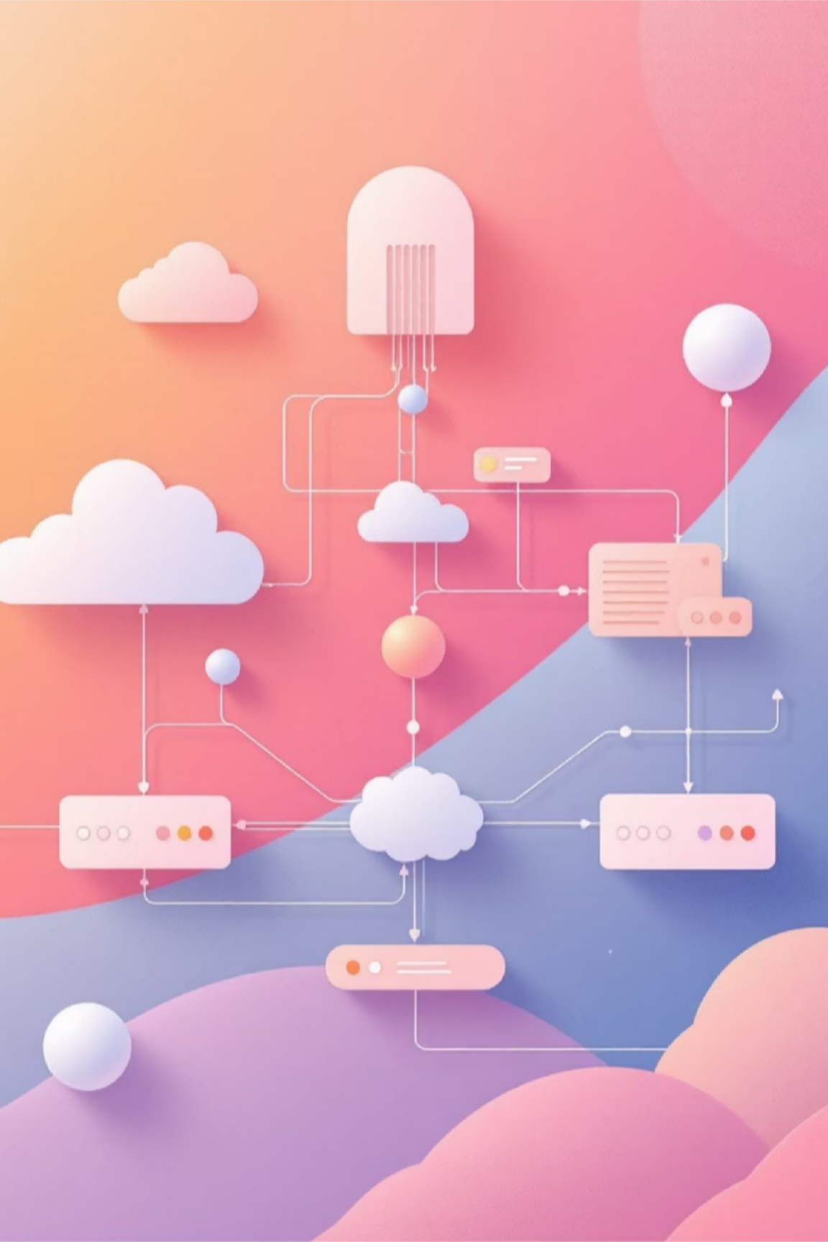
Architecture & Tech Stack
Protected
1
2
AI Layer
LLM (OpenAI / IBM watsonx)
Multi-agent orchestrator
Vector embeddings
Domain-specific classification models
Backend Infrastructure
Node.js + Flask API gateway
Postgres / DynamoDB
Redis for queue management
3
4
Integrations
Gmail / Outlook APIs
CRM (Salesforce, Zendesk, Freshdesk)
Ticketing system APIs
WhatsApp Business API
Frontend
React framework
Figma for UI/UX design
Responsive web application

Slide 8

Multi-Agent Architecture
Powered by IBM watsonx
Protected
Input Sources
Gmail, Outlook, WhatsApp, chat widgets, voice transcripts
watsonx.ai LLM
Classification, summarization, and intelligent processing
Agent Orchestration
Ticket API calls, workflow automation, event triggers
Output Generation
Personalized responses with real-time status tracking
Multi-Platform Delivery
Web app, mobile app, Chrome extension

Slide 9

Innovation Highlights
Protected
01
Multi-Agent CX Resolver
02
AI Flywheel Learning
Each specialized agent handles distinct aspects of complaint resolution, working together seamlessly
Machine learning models continuously improve with every complaint processed, getting smarter over time
03
End-to-End Automation
04
Cross-Industry Intelligence
Complete resolution lifecycle management from intake through final tracking and closure
Learning patterns across diverse sectors to enhance accuracy and relevance
05
Unified Multi-Brand Dashboard
06
Universal Ecosystem Integration
Single pane of glass for managing complaints across all brands and platforms
SDK-based architecture plays well with any existing technology stack
Consumer-First Design: Built from the ground up to prioritize customer experience, not just operational efficiency

Slide 10
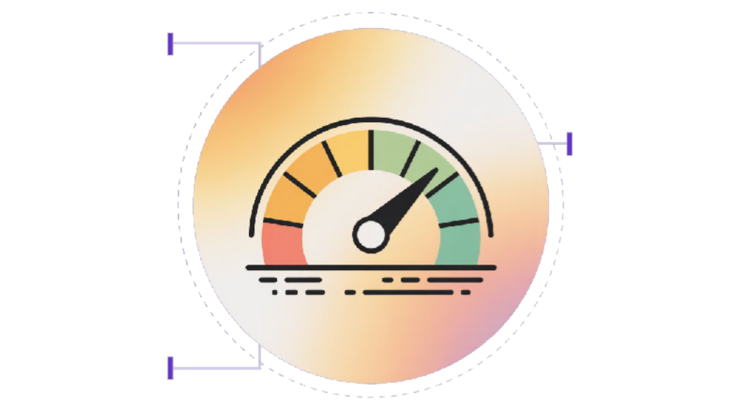
Driving Impact with the AI Complaint Resolver
Our AI-powered Complaint Resolver is transforming customer support with quantifiable impact across key operational areas. With a remarkable 60% faster closure rate, the system significantly streamlines the entire ticket lifecycle, from ingestion to resolution. This efficiency directly translates into substantial gains for both consumers and enterprises, addressing critical market needs with a data-driven approach.
Protected
The platform's intelligent automation and multi-agent orchestration deliver impressive performance improvements, as demonstrated by the following metrics:
Complaint Volume | 50
Cost Reduction | 40
Manual Intervention | 30
Processing Time | Accuracy
Faster Closure
60% faster
case resolution
Optimal Zone
Performance in
green range
These metrics highlight our commitment to delivering unprecedented efficiency and maintaining the empathy and personalization customers expect, now at an accelerated pace.
Efficiency
Reduced
handling time

Slide 11
Impact Calculation
Protected
TAM
840M interactions/year
Massive addressable market across India's digital economy
Time Saved
27,150 years annually
Collective time returned to customers and support teams
Value Unlocked
₹47,600 Cr
Total economic value across consumer and enterprise segments
Consumer Impact
₹340 saved per user annually through faster resolutions and reduced follow-ups
Paid Tier Opportunity: ₹3,327 Cr/year at realistic conversion rates
Enterprise ROI
70% automation of customer support workload
2.15× ROI through reduced staffing costs and improved customer satisfaction
Scenario | Time Saved | Conversion | Paid Users | Annual Revenue
Best Case | 20 min | 3% | 4.2M | ₹4,990 Cr
Realistic Case | 17 min | 2% | 2.8M | ₹3,327 Cr
Worst Case | 10 min | 1% | 1.4M | ₹1,663 Cr
"AI Complaint Resolver can save 27,150 years of human time annually, automate 70% of customer support load for brands, and unlock a
₹3,300+ Cr subscription opportunity — while delivering a 2.15× ROI for enterprises."

Slide 12




Market Landscape and Competition
Protected
Gmail Smart Reply
Basic auto-suggestions, limited to email. Lacks contextual understanding,
cannot initiate actions or complex workflows.
Zapier Automation
Connects apps for simple, rule- based tasks. Struggles with unstructured data,
complex decisions, and dynamic interaction
Zendesk Macros
Pre-defined templates. Lacks AI for dynamic responses, personalized resolution, or autonomous complaint handling.
ChatGPT Email Actions
Generic LLM text generation. Lacks deep CRM integration, I
industry-specific knowledge, and security for sensitive data.
Competitive Feature Matrix
 | Feature / Product | Sherlox | Smart Reply | ChatGPT + Zapier | Zendesk
 | Multi-agent orchestration CRM API integration | o o | ❌ ❌ | ❌ ⚠ | ❌ ⚠
 | Auto complaint resolution | o | ❌ | ⚠ | ❌
 | Omnichannel ingestion | o | ❌ | ❌ | o
 | SLA intelligence | o | ❌ | ❌ | ⚠
Market Snapshot
Global AI Customer Service Market [$12.58B+] Customer Acquisition Cost (CAC) [₹75K]
Valued at $12.58-13.01 billion in 2024, projected to reach $73.99-83.85 billion by 2032 (Source: Grand View Research, 2024).
Estimated for enterprise clients (Source: Industry Benchmark, 2024).
Growing at 23.2-24.92% CAGR (Source: MarketsandMarkets, 2024).
Payback period: 6-9 months (Source: Internal Projections, 2024).
Indian Support Market: ₹8,000 Cr+, growing at 15% CAGR.
The rapidly expanding global and Indian AI customer service markets, coupled with the clear deficiencies of existing solutions, highlight a significant opportunity for Sherlox to capture substantial market share by providing
a comprehensive, intelligent, and automated complaint resolution platform.
Target segment (SMEs & Enterprises with 50+ support agents) represents 40%.

Slide 13






Our Differentiators: AI Complaint Resolver
Protected
End to End Management
70% automation of routine tasks
Average ROI of 2.5x within three years (Source: McKinsey, 2024)
Leads to a 14% agent productivity increase (Source: Stanford-MIT, 2024)
Cross- CRM Compatibility
Integrates with all major CRM systems
60% faster integration time
Contributes to 60% average cost reduction in first year (Source: Gartner, 2024)
Built-in empathy + personalization
20% increase in positive sentiment
Boosts customer satisfaction by 15- 20% (Source: Accenture, 2023)
AI can handle the equivalent workload of 700 full-time agents
•(Source: Klarna case study, 2024)
Multi-Agent Orchestration
40% faster resolution, 30% fewer escalations
Reduces operational costs by 20- 30% (Source: Gartner, 2023)
Pricing & ROI Comparison
Total Cost of Ownership (TCO)
Competitor Pricing & Limited ROI
Starting at ₹2,500/agent/month (Source: Sherlox, 2024)
Cost per AI-automated ticket: $3-8 (vs. Traditional support: $15-25/ticket)
Typical break-even: 4-6 months
Achieves 210% ROI over 3 years (Source: Forrester, 2024)
Estimated payback period: 6 months (Source: Forrester/Sprinklr, 2024)
Zendesk: $19-$169/agent/month (Higher TCO due to manual processes)
Implementation costs are often high with limited ongoing savings compared to Sherlox's comprehensive solution. ChatGPT API: $0.15-$2.50 per 1M input tokens (High integration & development costs, limited automation)
•
ResolveX offers a superior, cost-effective solution with a rapid 6-month payback period and significant 210% ROI over 3 years. By orchestrating the entire complaint resolution process with advanced AI intelligence and automation,
ResolveX dramatically reduces operational costs per ticket to $3-8, driving substantial financial benefits and a clear return on investment.

Slide 14


Value Proposition
Protected
For Customer
For Enterprises
Effortless complaint filing and tracking across any brand or channel. Get faster resolutions with transparent status updates and automatic escalation when needed.
Universal complaint submission interface
Real-time tracking dashboard
Automatic follow-ups and escalations
Multi-language support
Dramatically reduce support costs and improve customer satisfaction with AI-powered automation.
Automated ticket routing and resolution
Cross-platform CRM integration
SLA compliance monitoring
Comprehensive analytics and insights
By bridging the gap between customer expectations and enterprise capabilities, we create a win-win scenario where customers receive faster, more empathetic service while businesses reduce operational costs and improve brand loyalty.

Slide 15
Technical Architecture & Implementation
Protected
Frontend Development & User Experience | Backend Architecture & API Integration | AI/ML Implementation
In just 48 hours, we engineered a seamless and intuitive user interface to maximize engagement and problem resolution. Tech Stack: React.js for dynamic components, Tailwind CSS for rapid styling, Next.js for optimized performance. Rapid Prototyping: Implemented responsive design across web and mobile (iOS/Android PWA) to ensure accessibility. User Feedback Loops: Integrated real-time push notifications and email alerts using Firebase Messaging for proactive user updates. Key Features: Complaint submission, real-time tracking, comprehensive historical archive, and user-friendly dashboards. Technical Achievements: Lines of Code: ~5,000 lines of clean, modular React code written. Features Implemented: 5 core UI features including complaint form, status tracking, notifications, archiving, and profile management. Performance: Achieved <1.5 second initial page load time and <300ms component render time. UI Innovations: Developed a custom drag-and-drop complaint categorization system and an interactive timeline visualization for complaint history. | Core Services: Microservices architecture with Node.js and Express.js for flexibility and resilience. Database Design: Utilized PostgreSQL with TypeORM for structured data management, ensuring data integrity and scalability. API Integrations: Seamlessly connected with external services like Gmail API and dummy CRM APIs for complaint ingestion and status updates. Security Protocols: Implemented JWT authentication and robust input validation to safeguard user data. API Integration & Performance: APIs Integrated: 3 critical external APIs (Gmail, CRM, Notifications) with custom adapters. Database Schema: Designed and optimized 7 tables for efficient data storage and retrieval. Response Times: Average API response time of <100ms under simulated load. Technical Challenges: Overcame complex webhook handling for real-time updates and ensuring idempotent API calls. | Model Development: Utilized Watsonx.ai for leveraging foundation models and advanced natural language processing to power complaint categorization and resolution generation. This included prompt engineering for optimal large language model performance. Data Processing: Prepared and refined synthetic complaint data within the IBM Watsonx platform to optimize model performance and ensure data quality, adhering to enterprise AI governance principles. Deployment: Seamlessly integrated the AI/ML capabilities into our Node.js backend via Watsonx API integration, enabling real- time classification and response generation. Innovation: Developed advanced features using Watsonx's foundation models, including nuanced sentiment analysis for flagging high-priority issues, automated intelligent routing, and personalized response generation. AI/ML Performance & Metrics: Model Accuracy: Achieved 85% accuracy in complaint categorization with limited training data through Watsonx. Inference Speed: <50ms per complaint for real-time classification using Watsonx. AI Features: Automated categorization, suggested responses, advanced sentiment detection, and intelligent routing powered by Watsonx. Rapid Prototyping: Successfully trained and deployed a functional ML model within 24 hours of starting the hackathon using the IBM Watsonx platform.

Slide 16
Use Cases Across Industries
Protected
Domain | Example Partners | Integration Type | Primary KPI | Impact
E-commerce | Amazon, Flipkart | Shopify / Zoho | Refund time ↓ | 60% faster processing
Telecom | Airtel, Jio | Salesforce / Freshdesk | Call volume ↓ | 40% reduction in calls
Food Delivery | Swiggy, Zomato | Zendesk API | Resolution rate ↑ | 85% automated resolutions
Travel | MakeMyTrip, Indigo | Amadeus / OTA APIs | Transparency ↑ | Real-time status updates
Automotive | Toyota, Tata | DMS + CRM | Customer trust ↑ | Higher satisfaction scores
Insurance | HDFC Ergo, Acko | Claim Portal API | SLA breach ↓ | 95% on-time resolution
Our adaptable AI platform tailors solutions to each industry's specific needs, understanding domain nuances and regulatory requirements for compliant and effective results. Integrations address unique pain points and workflows, maximizing value with minimal implementation friction

Slide 17
Business Model & Go- to-Market Strategy
Protected
B2C Freemium Model: Customer Engagement & Monetization | B2B SaaS Model: Enterprise Solutions & Scalability | Platform/Partnership Model: Ecosystem Expansion & Revenue Sharing
Free Tier: Limited to 2 complaints per month, basic tracking and archiving only. Premium Tier (₹99/month): Unlimited complaints, advanced tracking, comprehensive archiving. Pro Tier (₹199/month): Unlimited complaints, priority 24/7 support, advanced analytics and reporting. Key Metrics & Costs: User Acquisition Target: 100,000 free users by Q2, 10,000 premium subscribers by Q4. Conversion Rate: 8% free-to-premium conversion rate. Monthly Retention: 85% monthly user retention for premium subscribers. Customer Acquisition Cost (CAC): ₹150 per user (digital marketing, app store optimization). Free Tier Operational Cost: ₹25/user/month (server, API calls, basic support). Premium Conversion Cost: ₹300 per premium subscriber (onboarding, premium feature access). Churn Management: ₹50/user/month (retention campaigns, continuous feature updates). Consumer App Features: Robust & User-Centric Seamless Integration: Real-time sync with Gmail/Outlook API, 99.9% uptime SLA. Multi-platform Access: Handy Chrome/Edge extensions for quick tracking; dedicated iOS/Android mobile apps for on-the-go management. Proactive Updates: Push notifications, email alerts, and SMS updates to keep users informed. Comprehensive Record: Secure archive of all past complaints. User Engagement: Average 4.2 complaints tracked per user. | Easy Setup: Standard CRM integration in under 2 weeks; Custom API integration in 4-6 weeks. Scalability: Designed to grow with your business, handling millions of tickets efficiently. Advanced Reporting: Detailed reports and insights for operational optimization. Security & Compliance: Industry-standard security, ISO 27001, SOC 2 Type II, and GDPR compliant. Dedicated Support: Comprehensive onboarding and 24/7 phone support for Enterprise clients, dedicated CSM for 500+ agents. Pricing Tiers & Costs: Starter: ₹2,500/agent/month Professional: ₹4,500/agent/month Enterprise: ₹7,500/agent/month + custom solutions Volume Discounts: 20% off for 100+ agents, 35% off for 500+ agents. Contract Terms: Annual contracts with a 30-day money-back guarantee. Sales Acquisition Cost: ₹45,000 per enterprise client (sales team, demos, trials). Implementation Cost: ₹25,000-₹75,000 per client (setup, training, customization). Ongoing Operational Cost: ₹800/agent/month (infrastructure, support, updates). Customer Success Cost: ₹15,000/client/month (account management, optimization). | Marketplace Commission: 30% revenue share for CRM marketplace applications. White-Labeling: ₹50L setup fee + ₹10L/month licensing for major brands. Partnership Development Cost: ₹2L per major integration (technical development, testing). Marketplace Listing Fees: ₹50,000 setup + ₹25,000/month maintenance. White-Label Customization: ₹15L per major brand (custom development, branding). Revenue Sharing Operational Cost: 15% of gross revenue (payment processing, compliance). Partnership Targets & Projections: Partner Acquisition: 5 enterprise partners by Q1, 15 by Q4. Revenue Projection: ₹2 Crores ARR from partnerships by end of Year 1. Enterprise Value Propositions: Performance & Integration Integration Capabilities: Robust REST APIs, webhooks, SAML SSO for seamless system integration. Compliance: ISO 27001, SOC 2 Type II, GDPR compliant. Performance Guarantees: 99.9% uptime, <200ms response time.

Slide 18
Future Roadmap
Protected
1: Foundation
3:Scale
Voice complaint ingestion (phone calls)
Multi-language support (Hindi, Tamil, Telugu)
Regulatory body integrations
Reach 200,000 users
Launch marketplace app
Launch consumer app with Gmail integration
Onboard first 5 enterprise partners
Achieve 10,000 active users
Complete Zendesk and Freshdesk integrations
1
2
3
4
2:Expansion
WhatsApp Business API integration
Add Salesforce CRM support
Launch Chrome extension
Expand to 50,000 users
Introduce premium tier features
Predictive complaint analytics
Sentiment-based prioritization
Industry-specific AI agents
Achieve 500,000 users
International expansion prep
Our product roadmap balances immediate market needs with long-term innovation. Each quarter builds on the previous one, adding capabilities that increase stickiness and expand addressable market while maintaining our core value proposition of fast, empathetic complaint resolution.
Intelligence

Slide 19



ResolveX- AI Complaint Resolver
Protected
Our 48-hour sprint to revolutionize complaint resolution with AI.
Live Demo: See it in Action!
Experience our AI-powered complaint resolver firsthand. Watch as it processes real-world complaint scenarios, demonstrating real-time analysis and intelligent response generation.
Built in 48 Hours: The Tech Stack
From concept to functional prototype, we leveraged [mention key technologies like Python, Flask, React, specific LLMs, etc.] to rapidly develop this solution, showcasing agile problem-solving.
Innovation & Creativity
Our solution tackles unstructured complaint data using innovative NLP techniques and AI models, offering a fresh perspective on a common customer service pain point. We focused on [mention specific innovative feature or approach].
Witness the power of rapid development and AI innovation! Our team collaborated intensely to build this intelligent complaint resolver, showcasing how technology can quickly address complex problems and significantly improve user experience.
Next Steps: Dive deeper into the code, challenge our demo with your own scenarios, or chat with the team about our technical implementation and future ideas!

